Slide 1

Visual C Sharp ® How to Program
Sixth Edition
Chapter 19
Custom Linked Data Structures
Copyright © 2017 Pearson Education, Inc. All Rights Reserved
Notes:
If this PowerPoint presentation contains mathematical equations, you may need to check that your computer has the following installed:
1) MathType Plugin
2) Math Player (free versions available)
3) NVDA Reader (free versions available)

Slide 2
Learning Objectives
Form linked data structures using references, self-referential classes and recursion.
Learn how boxing and unboxing enable simple-type values to be used where objects are expected in a program.
Create and manipulate dynamic data structures, such as linked lists, queues, stacks and binary trees.
Learn various important applications of linked data structures.
Create reusable data structures with classes, inheritance and composition.

Slide 3
Outline
19.1 Introduction
19.2 Simple-Type structs, Boxing and Unboxing
19.3 Self-Referential Classes
19.4 Linked Lists
19.5 Stacks
19.6 Queues
19.7 Trees
19.7.1 Binary Search Tree of Integer Values
19.7.2 Binary Search Tree of Icomparable Objects
19.8 Wrap-Up

Slide 4
19.1 Introduction (1 of 2)
This chapter enhances our discussion of dynamic data structures that grow and shrink at execution time.
Linked lists are collections of data items “lined up in a row” or “chained together”—users can make insertions and deletions anywhere in a linked list.
Stacks are important in compilers and operating systems; insertions and deletions are made at only one end—its top.

Slide 5
19.1 Introduction (2 of 2)
Queues represent waiting lines; insertions are made at the back (also referred to as the tail) of a queue, and deletions are made from the front (also referred to as the head) of a queue.
Binary trees facilitate high-speed searching and sorting of data, efficient elimination of duplicate data items, representation of file-system directories and compilation of expressions into machine language.
These data structures have many other interesting applications as well.

Slide 6
19.2 Simple-Type structs, Boxing and Unboxing (1 of 4)
Simple-Type structs
Each simple type (see Appendix B, Simple Types) has a corresponding struct in namespace System that defines the simple type.
These structs are called Boolean, Byte, SByte, Char, Decimal, Double, Single, Int16, UInt16 Int32, UInt32, Int64 and UInt64.
Types declared with keyword struct are value types.

Slide 7
19.2 Simple-Type structs, Boxing and Unboxing (2 of 4)
Simple types are actually aliases for their corresponding structs, so a variable of a simple type can be declared using either the keyword for that simple type or the struct name—e.g., int and Int32 are interchangeable.
The methods related to a simple type are located in the corresponding struct (e.g., method Parse, which converts a string to an int value, is located in struct Int32).

Slide 8
19.2 Simple-Type structs, Boxing and Unboxing (3 of 4)
Boxing and Unboxing Conversions
Simple types and other structs inherit from class ValueType in namespace System. Class ValueType inherits from class object.
Thus, any simple-type value can be assigned to an object variable; this is referred to as a boxing conversion and enables simple types to be used anywhere objects are expected.
In a boxing conversion, the simple-type value is copied into an object so that the simple-type value can be manipulated as an object.

Slide 9
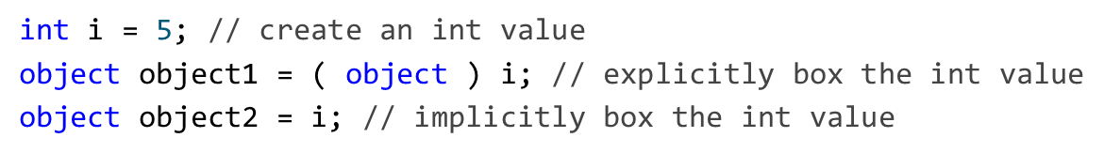
19.2 Simple-Type structs, Boxing and Unboxing (4 of 4)
Boxing conversions can be performed either explicitly or implicitly as shown in the following statements:
After executing the preceding code, both object1 and object2 refer to two different objects that contain a copy of the integer value in int variable i.
An unboxing conversion can be used to explicitly convert an object reference to a simple value, as shown in the following statement:
Explicitly attempting to unbox an object reference that does not refer to the correct simple value type causes an InvalidCastException.

Slide 10
19.3 Self-Referential Classes (1 of 3)
A self-referential class contains a reference member that refers to an object of the same class type.
For example, the class declaration in Figure 19.1 defines the shell of a self-referential class named Node.
This type has two properties—int Data and Node reference Next.
Next references an object of type Node, an object of the same type as the one being declared here—hence, the term “self-referential class.”
Next is referred to as a link (i.e., Next can be used to “tie” an object of type Node to another object of the same type).

Slide 11
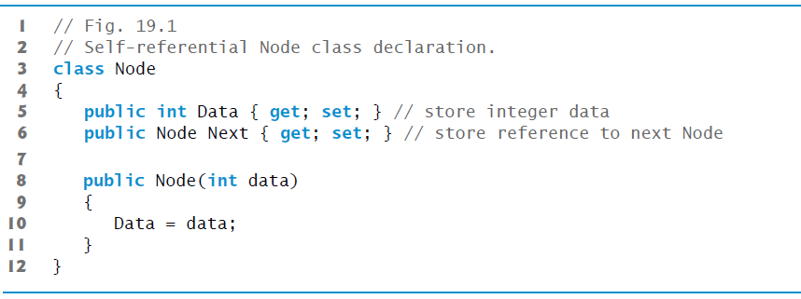
Figure 19.1 Self-Referential Node Class Declaration

Slide 12
19.3 Self-Referential Classes (2 of 3)
Figure 19.2(see slide 14) illustrates two self-referential objects linked together to form a linked list.
A backslash (representing a null reference) is placed in the link member of the second self-referential object to indicate that the link does not refer to another object.
The backslash is for illustration purposes; it does not correspond to the backslash character in
A null link normally indicates the end of a data structure.

Slide 13
19.1 Common Programming Error
Not setting the link in the last node of a list to null is a logic error.

Slide 14

Figure 19.2 Self-Referential Class Objects Linked Together

Slide 15
19.3 Self-Referential Classes (3 of 3)
Creating and maintaining dynamic data structures requires dynamic memory allocation—a program’s ability to obtain more memory space at execution time to hold new nodes and to release space no longer needed.
The new operator is essential to dynamic memory allocation.
Operator new takes as an operand the type of the object being dynamically allocated and returns a reference to an object of that type.
For example, the statement
Node nodeToAdd = new Node(10);
allocates the appropriate amount of memory to store a Node, initializes it and stores a reference to this object in nodeToAdd.
If no memory is available, new throws an OutOfMemoryException.
The constructor argument 10 specifies the Node object’s data.

Slide 16
19.4 Linked Lists (1 of 14)
A linked list is a linear collection (i.e., a sequence) of self-referential class objects, called nodes, connected by reference links—hence, the term “linked” list.
A program accesses a linked list via a reference to the first node of the list.
Each subsequent node is accessed via the link-reference member stored in the previous node.
By convention, the link reference in the last node of a list is set to null to mark the end of the list.

Slide 17
19.4 Linked Lists (2 of 14)
Data is stored in a linked list dynamically—that is, each node is created as necessary.
A node can contain data of any type, including references to objects of other classes.
Stacks and queues are also linear data structures—in fact, they may be viewed as constrained versions of linked lists.
Trees are nonlinear data structures.

Slide 18
19.4 Linked Lists (3 of 14)
Lists of data can be stored in arrays, but linked lists provide several advantages.
A linked list is appropriate when the number of data elements to be represented in the data structure is unpredictable.
Unlike a linked list, the size of a conventional
array cannot be altered, because the array size is fixed at creation time.
Conventional arrays can become full, but linked lists become full only when the system has insufficient memory to satisfy dynamic memory allocation requests.

Slide 19
Performance Tip 19.1
An array can be declared to contain more elements than the number of items expected, possibly wasting memory. Linked lists provide better memory utilization in these situations, because they can grow and shrink at execution time.

Slide 20
19.4 Linked Lists (4 of 14)
Programmers can maintain linked lists in sorted order simply by inserting each new element at the proper point in the list (locating the proper insertion point does take time).
They do not need to move existing list elements.
Normally linked-list nodes are not stored contiguously in memory.
Rather, the nodes are logically contiguous.
Figure 19.3(see slide 23) illustrates a linked list with several nodes.

Slide 21
Performance Tip 19.2
The elements of an array are stored contiguously in memory to allow immediate access to any array element—the address of any element can be calculated directly from its index. Linked lists do not afford such immediate access to their elements—an element can be accessed only by traversing the list.

Slide 22
Performance Tip 19.3
Using linked data structures and dynamic memory allocation (instead of arrays) for data structures that grow and shrink at execution time can save memory. Keep in mind, however, that reference links occupy space, and dynamic memory allocation incurs the overhead of method calls.

Slide 23
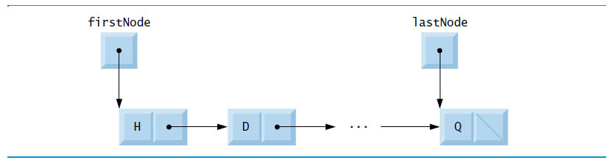
Figure 19.3 Linked List Graphical Representation

Slide 24
19.4 Linked Lists (5 of 14)
Linked-List Implementation
Figures 19.4–19.5(see slide 26–35) use an object of our List class to manipulate a list of miscellaneous object types.

Slide 25
Performance Tip 19.4
Insertion and deletion in a sorted array can be time consuming—all the elements following the inserted or deleted element must be shifted appropriately.

Slide 26
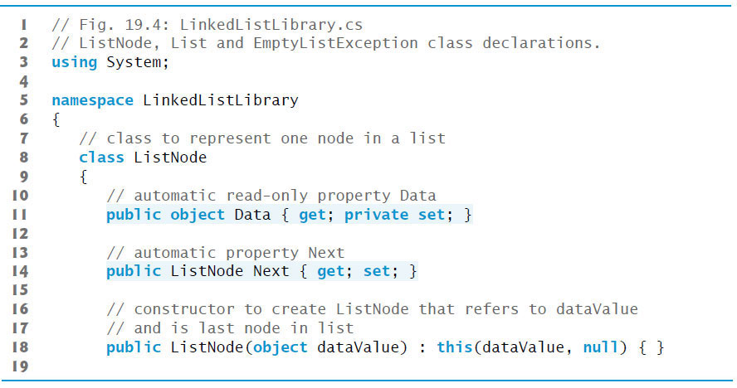
Figure 19.4 ListNode, List and EmptyListException Class Declarations (1 of 9)

Slide 27
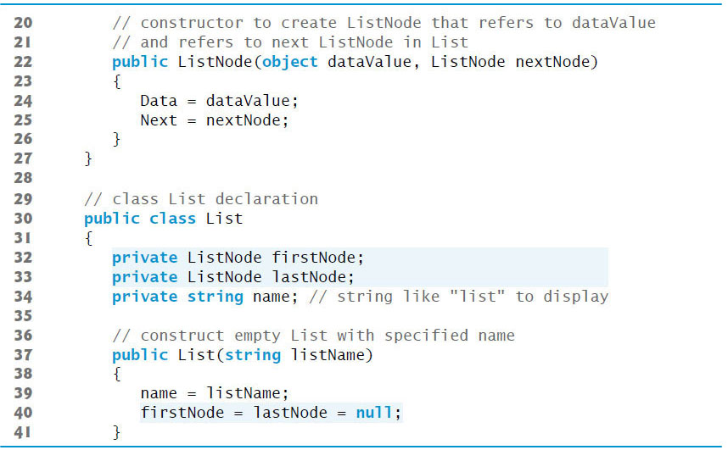
Figure 19.4 ListNode, List and EmptyListException Class Declarations (2 of 9)

Slide 28
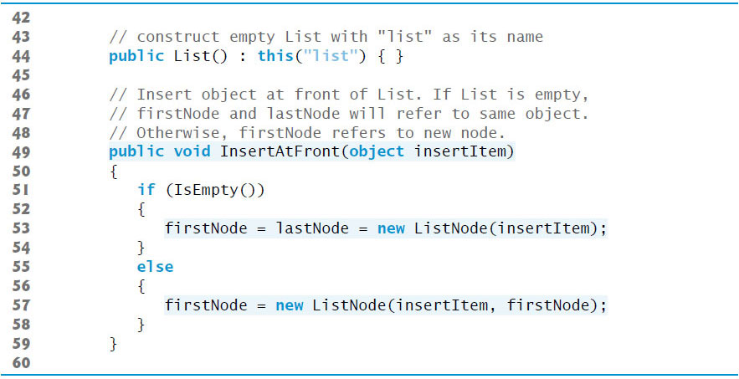
Figure 19.4 ListNode, List and EmptyListException Class Declarations (3 of 9)

Slide 29
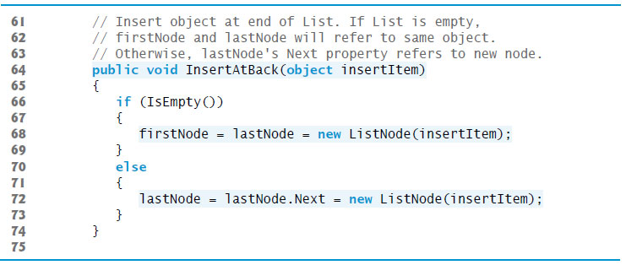
Figure 19.4 ListNode, List and EmptyListException Class Declarations (4 of 9)

Slide 30
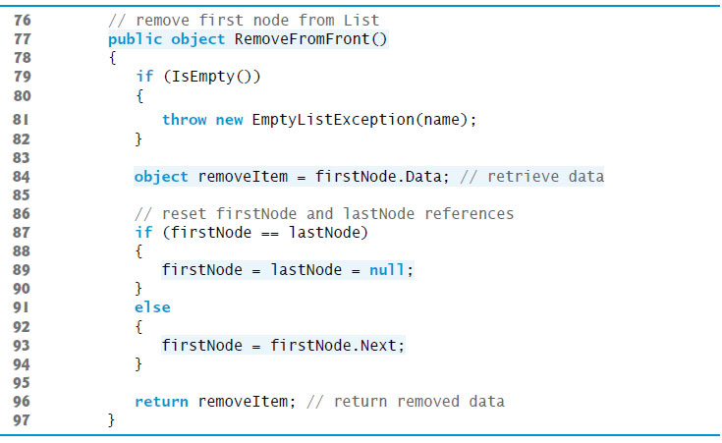
Figure 19.4 ListNode, List and EmptyListException Class Declarations (5 of 9)

Slide 31
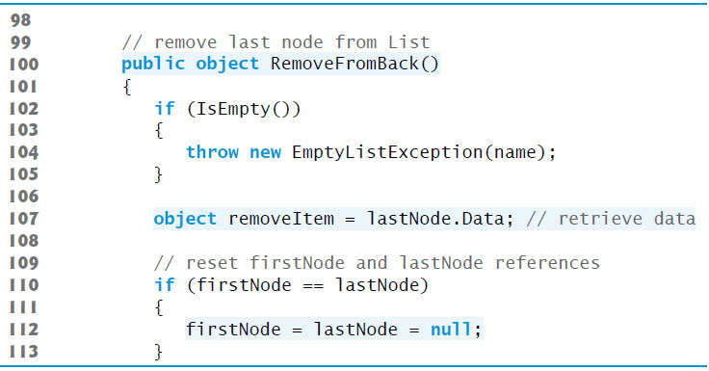
Figure 19.4 ListNode, List and EmptyListException Class Declarations (6 of 9)

Slide 32
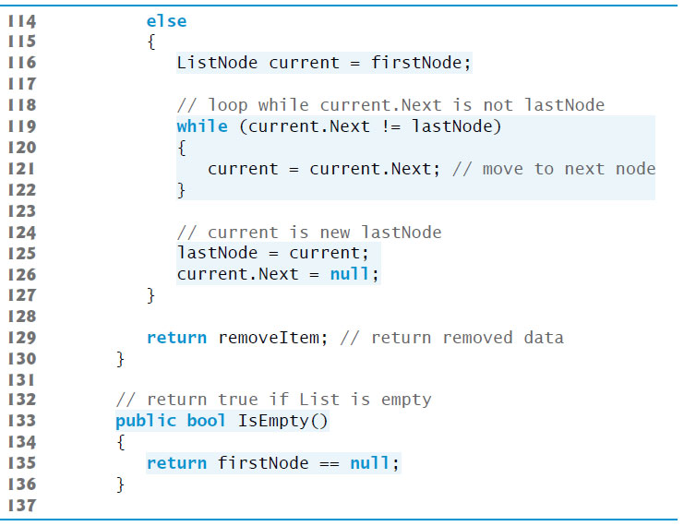
Figure 19.4 ListNode, List and EmptyListException Class Declarations (7 of 9)

Slide 33
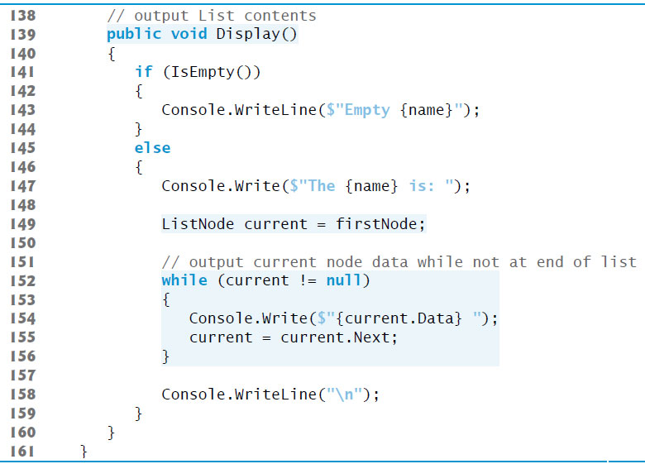
Figure 19.4 ListNode, List and EmptyListException Class Declarations (8 of 9)

Slide 34
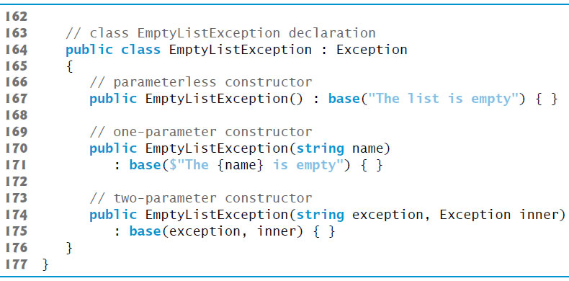
Figure 19.4 ListNode, List and EmptyListException Class Declarations (9 of 9)

Slide 35
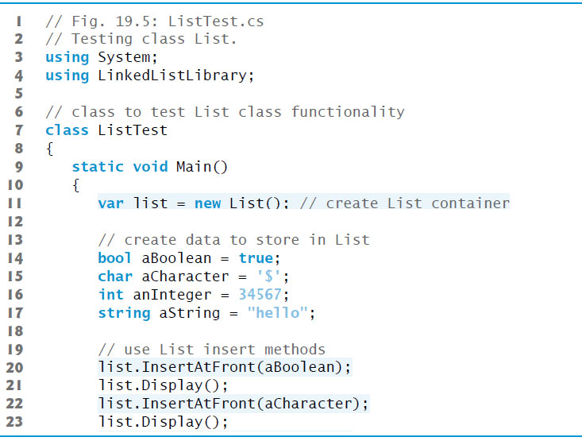
Figure 19.5 Testing Class List (1 of 4)

Slide 36
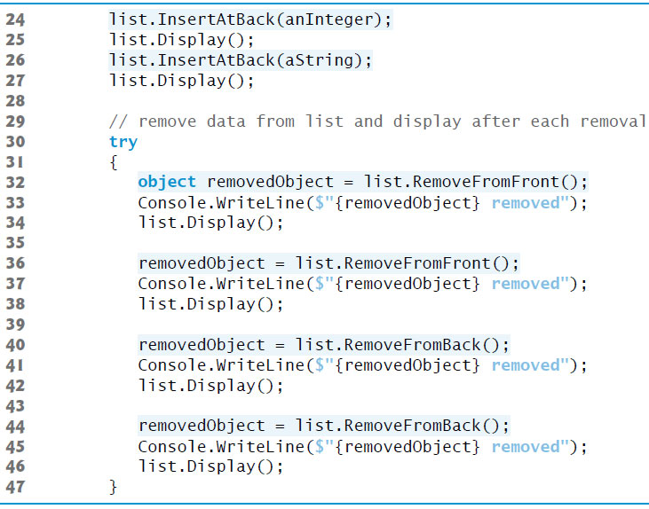
Figure 19.5 Testing Class List (2 of 4)

Slide 37
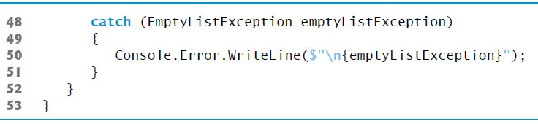
Figure 19.5 Testing Class List (3 of 4)

Slide 38
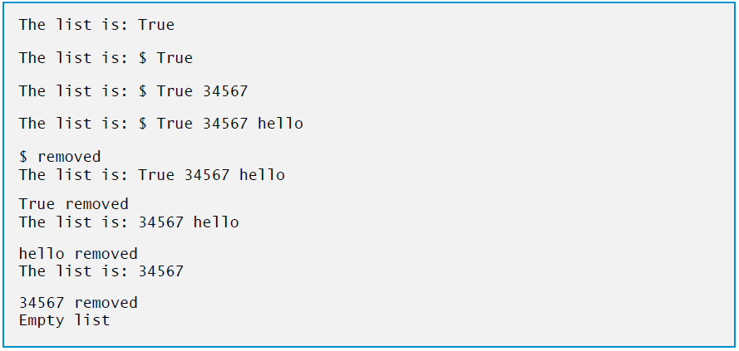
Figure 19.5 Testing Class List (4 of 4)

Slide 39
19.4 Linked Lists (6 of 14)
Method InsertAtFront
Method InsertAtFront places a new node at the front of the list.
The method consists of three steps:
Call IsEmpty to determine whether the list is empty.
If the list is empty, set both firstNode and lastNode to refer to a new ListNode initialized with insertItem. The ListNode constructor at line 18 calls the ListNode constructor at lines 22–26, which sets property Data to refer to the object passed as the first argument and sets the Next property’s reference to null.

Slide 40
19.4 Linked Lists (7 of 14)
If the list is not empty, the new node is “linked” into the list by setting firstNode to refer to a new ListNode object initialized with insertItem and firstNode.
When the ListNode constructor executes, it sets property Data to refer to the object passed as the first argument and performs the insertion by setting the Next reference to the ListNode passed as the second argument.

Slide 41
19.4 Linked Lists (8 of 14)
In Figure 19.6, part (a) shows a list and a new node during the InsertAtFront operation before the new node is linked into the list.
The dashed lines and arrows in part (b) illustrate Step 3 of the InsertAtFront operation, which enables the node containing 12 to become the new list front.

Slide 42
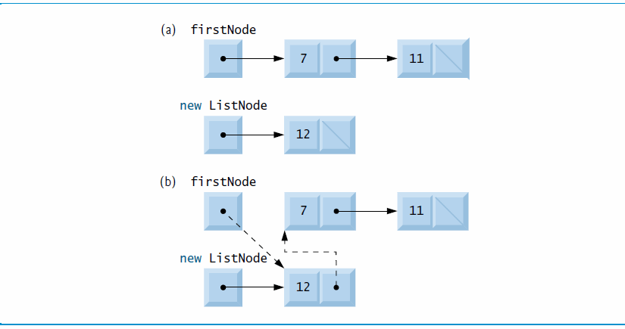
Figure 19.6 InsertAtFront Operation

Slide 43
Performance Tip 19.5
After locating the insertion point for a new item in a sorted linked list, inserting an element in the list is fast—only two references have to be modified. All existing nodes remain at their current locations in memory.

Slide 44
19.4 Linked Lists (9 of 14)
Method InsertAtBack
Method InsertAtBack places a new node at the back of the list.
The method consists of three steps:
Call IsEmpty to determine whether the list is empty (line 66).
If the list is empty, set both firstNode and lastNode to refer to a new ListNode initialized with insertItem (line 68). The ListNode constructor at line 18 calls the ListNode constructor at lines 22–26, which sets property Data to refer to the object passed as the first argument and sets the Next reference to null.

Slide 45
19.4 Linked Lists (10 of 14)
If the list is not empty, link the new node into the list by setting lastNode and lastNode.Next to refer to a new ListNode object initialized with insertItem (line 72). When the ListNode constructor (line 18) executes, it calls the constructor at lines 22–26, which sets property Data to refer to the object passed as an arument and sets the Next reference to null.
In Figure 19.7, part (a) shows a list and a new node during the InsertAtBack operation before the new node has been linked into the list.
The dashed lines and arrows in part (b) illustrate Step 3 of method InsertAtBack, which enables a new node to be added to the end of a list that is not empty.

Slide 46
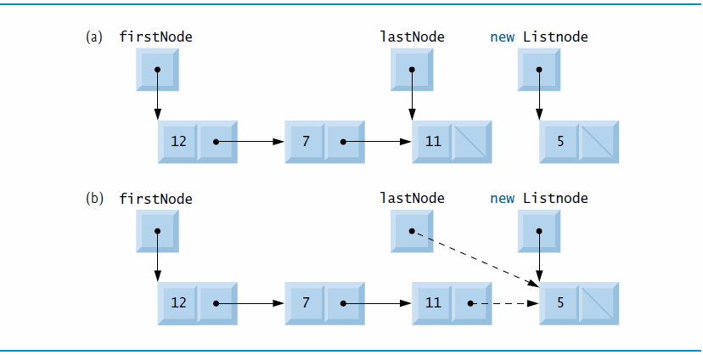
Figurer 19.7 InsertAtBack Operation

Slide 47
19.4 Linked Lists (11 of 14)
Method RemoveFromFront
In Figure 19.8, part (a) illustrates a list before a removal operation.
The dashed lines and arrows in part (b) show the reference manipulations.

Slide 48
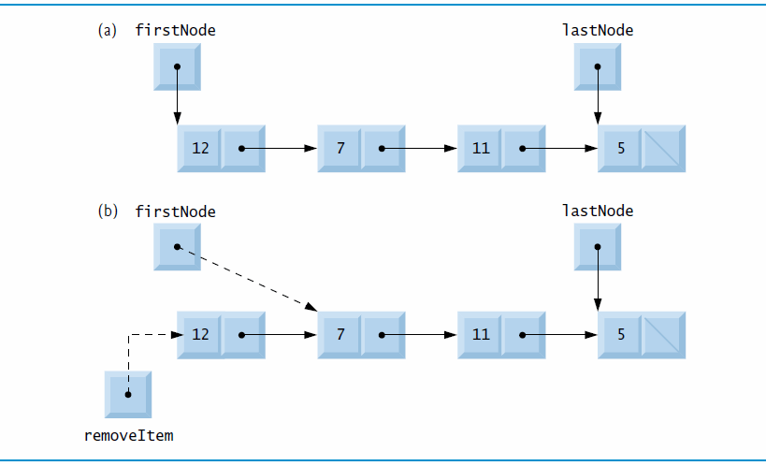
Figure 19.8 RemoveFromFront Operation

Slide 49
19.4 Linked Lists (12 of 14)
Method RemoveFromBack
In Figure 19.9, part (a) illustrates a list before a removal operation.
The dashed lines and arrows in part (b) show the reference manipulations.

Slide 50
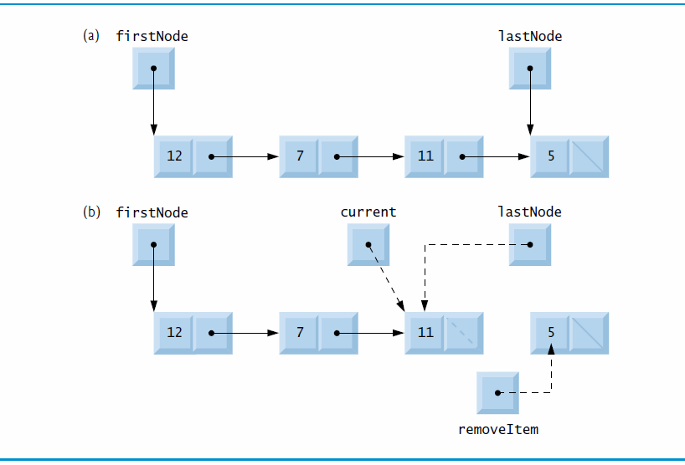
Figure 19.9 RemoveFromBack Operation

Slide 51
19.4 Linked Lists (13 of 14)
Linear and Circular Singly Linked and Doubly Linked Lists
A circular, singly linked list (Figure 19.10) begins with a reference to the first node, and each node contains a reference to the next node.
The “last node” does not contain a null reference; rather, the reference in the last node points back to the first node, thus closing the “circle.”

Slide 52
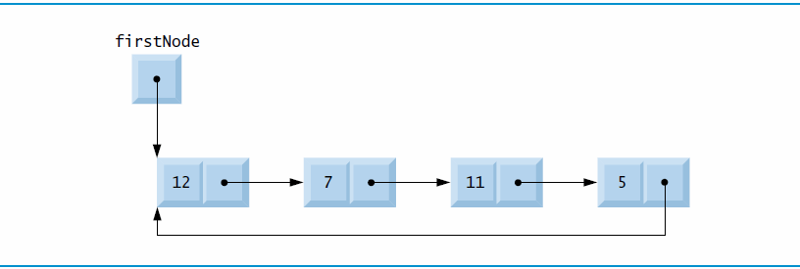
Figure 19.10 Circular, Singly Linked List

Slide 53
19.4 Linked Lists (14 of 14)
A doubly linked list (Figure 19.11) allows traversals both forward and backward. Such a list is often implemented with two “start references”—one that refers to the first element of the list to allow front-to-back traversal of the list and one that refers to the last element to allow back-to-front traversal.
In a circular, doubly linked list (Figure 19.12 see slide 55), the forward reference of the last node refers to the first node, and the backward reference of the first node refers to the last node, thus closing the “circle.”

Slide 54
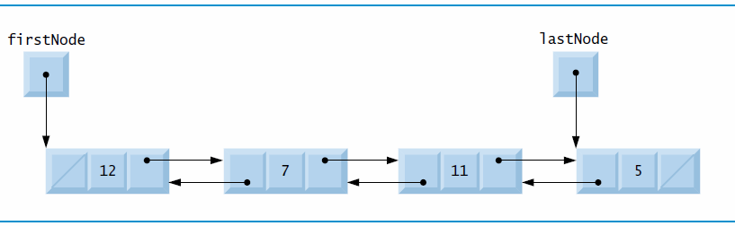
Figure 19.11 Doubly Linked List

Slide 55
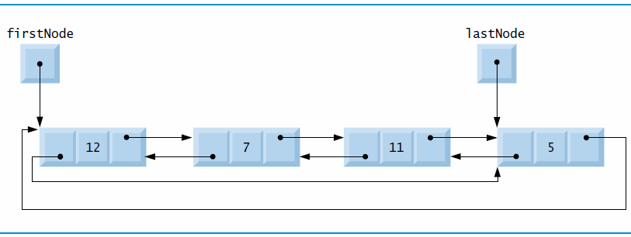
Figure 19.12 Circular, Doubly Linked List

Slide 56
19.5 Stacks (1 of 5)
A stack may be viewed as a constrained version of a linked list—it receives new nodes and releases nodes only at the top.
For this reason, a stack is referred to as a last-in, first-out (L I F O) data structure.
The primary operations to manipulate a stack are push and pop.
Operation push adds a new node to the top of the stack.
Operation pop removes a node from the top of the stack and returns the data item from the popped node.

Slide 57
19.5 Stacks (2 of 5)
Stack Class That Inherits from List
The code in Figure 19.13 creates a stack class by inheriting from class List of Figure 19.4 (see slide 61).

Slide 58
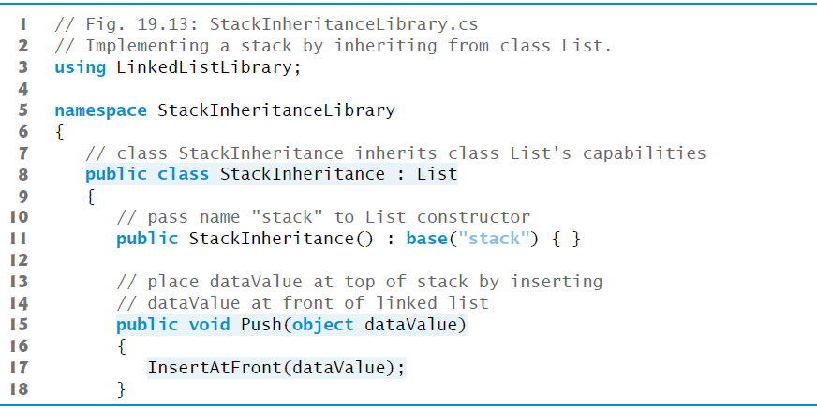
Figure 19.13 Implementing a Stack by Inheriting from Class List (1 of 2)

Slide 59
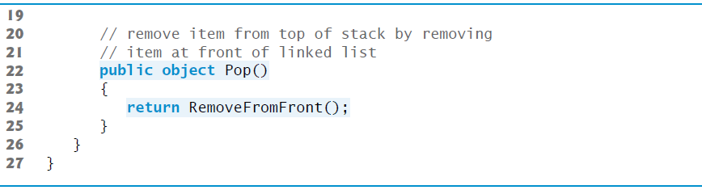
Figure 19.13 Implementing a Stack by Inheriting from Class List (2 of 2)

Slide 60
19.5 Stacks (3 of 5)
StackInheritanceTest’s Main method (Figure 19.14) uses class StackInheritance to create a stack of objects called stack.

Slide 61
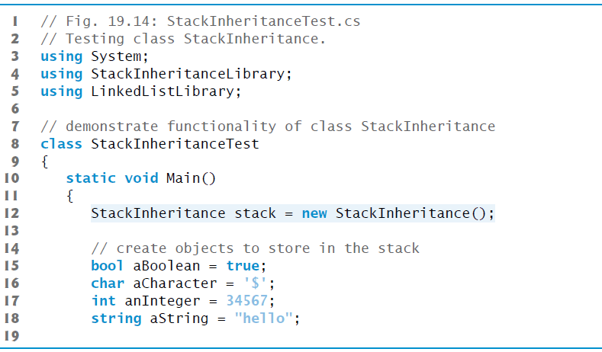
Figure 19.14 Testing Class StackInheritance (1 of 4)

Slide 62
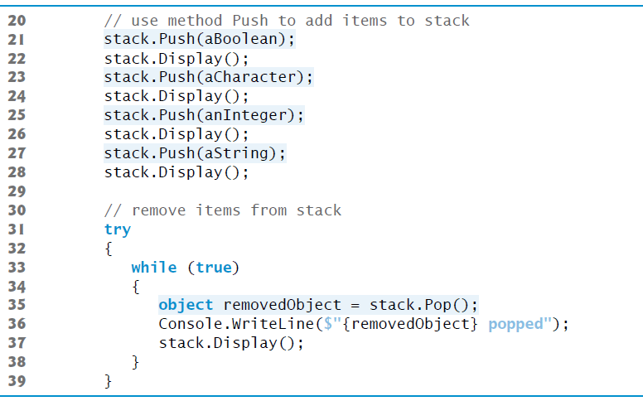
Figure 19.14 Testing Class StackInheritance (2 of 4)

Slide 63
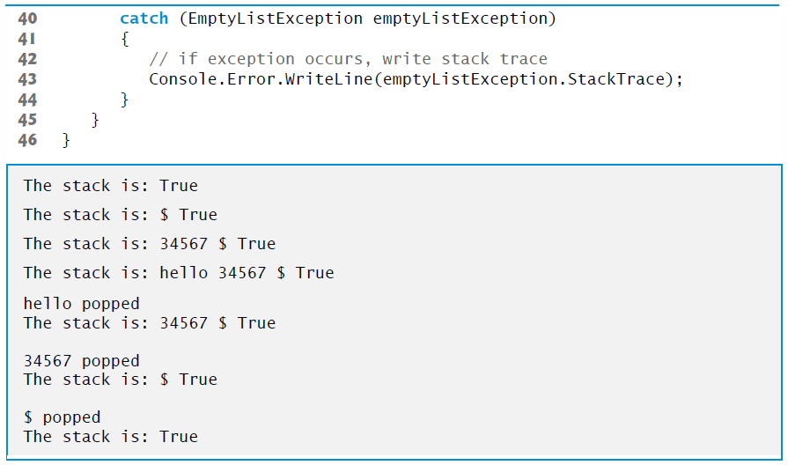
Figure 19.14 Testing Class StackInheritance (3 of 4)

Slide 64
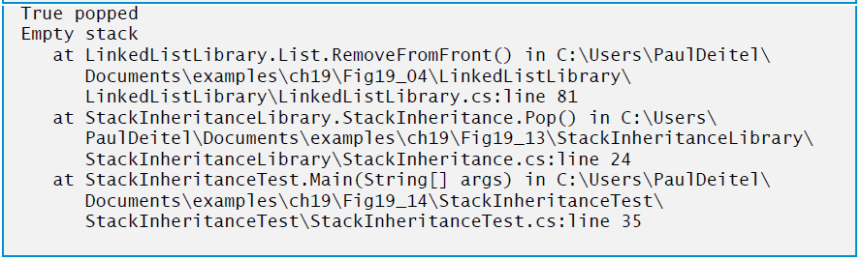
Figure 19.14 Testing Class StackInheritance (4 of 4)

Slide 65
19.5 Stacks (4 of 5)
Stack Class That Contains a Reference to a List
Another way to implement a stack class is by reusing a list class through composition. The class in Figure 19.15(see slide 67) uses a private object of class List (line 10) in the declaration of class StackComposition.
Composition enables us to hide the methods of class List that should not be in our stack’s public interface by providing public interface methods only to the required List methods.

Slide 66
19.5 Stacks (5 of 5)
This class implements each stack method by delegating its work to an appropriate List method.
StackComposition’s methods call List methods Insert-AtFront, RemoveFromFront, IsEmpty and Display.
In this example, we do not show class StackCompositionTest, because the only difference in this example is that we change the name of the stack class from StackInheritance to StackComposition.

Slide 67
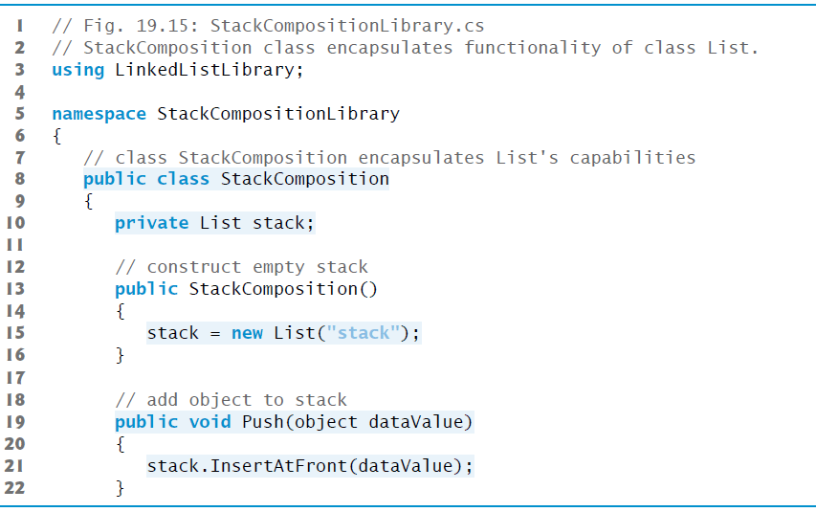
Figure 19.15 StackComposition Class Encapsulates Functionality of Class List (1 of 2)

Slide 68
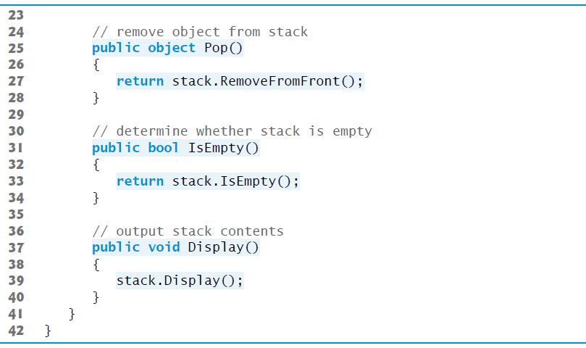
Figure 19.15 StackComposition Class Encapsulates Functionality of Class List (2 of 2)

Slide 69
19.6 Queues (1 of 4)
Another commonly used data structure is the queue.
Queue nodes are removed only from the head (or front) of the queue and are inserted only at the tail (or end).
For this reason, a queue is a first-in, first-out (F I F O) data structure.
The insert and remove operations are known as enqueue and dequeue.

Slide 70
19.6 Queues (2 of 4)
Queues are also used to support print spooling.
For example, a single printer might be shared by all users of a network.
Many users can send print jobs to the printer, even when the printer is already busy.
These print jobs are placed in a queue until the printer becomes available.
A program called a spooler manages the queue to ensure that as each print job completes, the next one is sent to the printer.

Slide 71
19.6 Queues (3 of 4)
Queue Class That Inherits from List
The code in Figure 19.16 creates a queue class by inheriting from a list class.

Slide 72
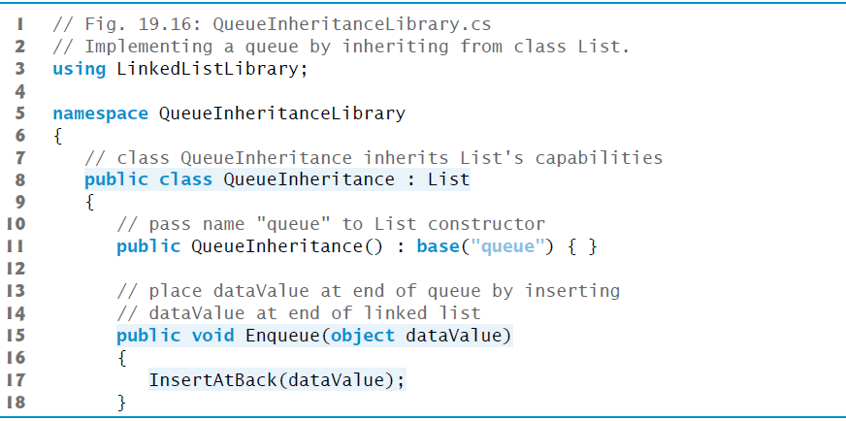
Figure 19.16 Implementing a Queue by Inheriting from Class List (1 of 2)

Slide 73
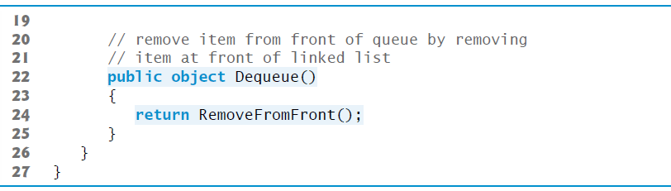
Figure 19.16 Implementing a Queue by Inheriting from Class List (2 of 2)

Slide 74
19.6 Queues (4 of 4)
Class QueueInheritanceTest’s Main method (Figure 19.17) creates a QueueInheritance object called queue.

Slide 75
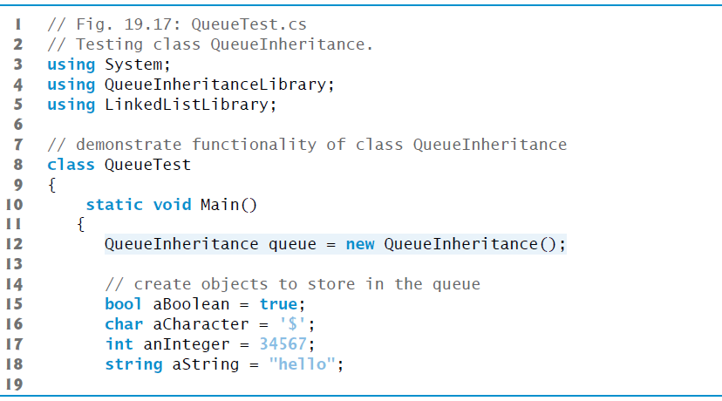
Figure 19.17 Testing Class QueueInheritance (1 of 4)

Slide 76
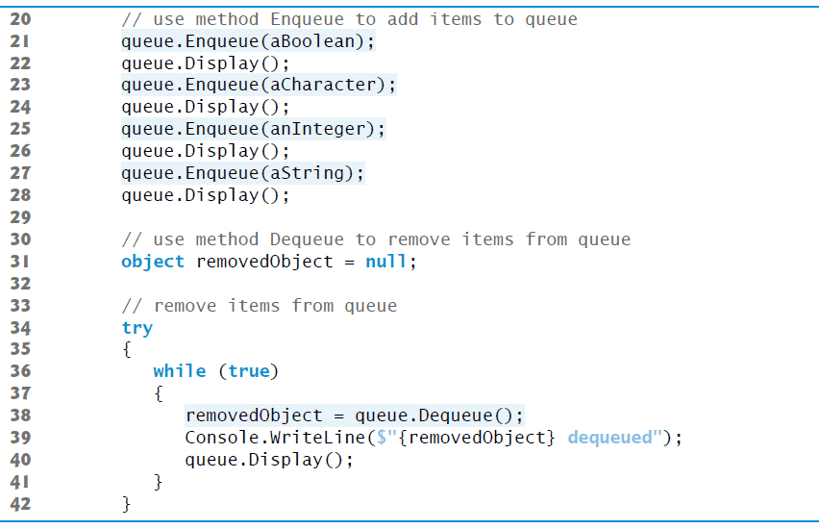
Figure 19.17 Testing Class QueueInheritance (2 of 4)

Slide 77
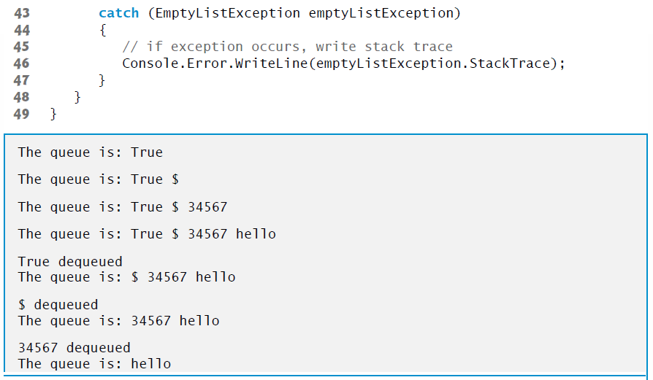
Figure 19.17 Testing Class QueueInheritance (3 of 4)

Slide 78
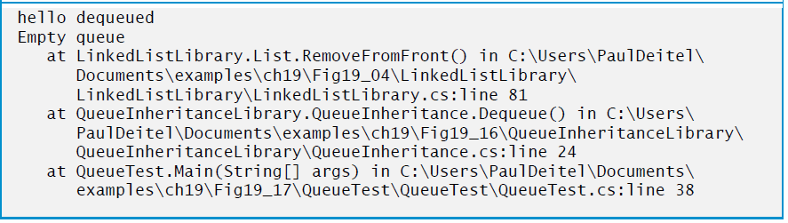
Figure 19.17 Testing Class QueueInheritance (4 of 4)

Slide 79
19.7 Trees (1 of 12)
Linked lists, stacks and queues are linear data structures (i.e., sequences).
A tree is a nonlinear, two-dimensional data structure with special properties. Tree nodes contain two or more links.

Slide 80
19.7 Trees (2 of 12)
Basic Terminology
With binary trees (Figure 19.18), each tree node contains two links (none, one or both of which may be null).
The root node is the first node in a tree.
Each link in the root node refers to a child.
The left child is the first node in the left subtree, and the right child is the first node in the right subtree.
The children of a specific node are called siblings.
A node with no children is called a leaf node.
Computer scientists normally draw trees from the root node down—the opposite of the way most trees grow in nature.

Slide 81
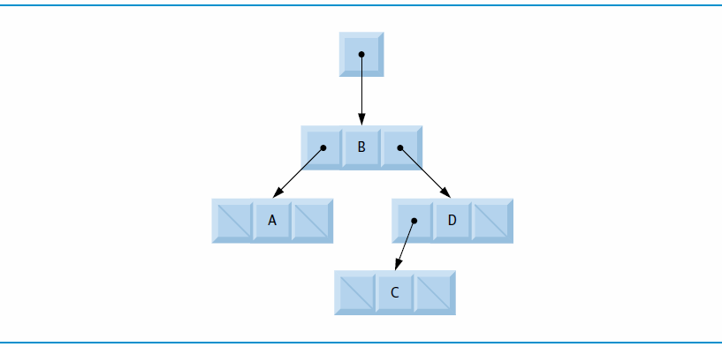
Figure 19.18 Binary-Tree Graphical Representation

Slide 82
19.7 Trees (3 of 12)
Binary Search Trees
In our binary-tree example, we create a special binary tree called a binary search tree.
A binary search tree (with no duplicate node values) has the characteristic that the values in any left subtree are less than the value in the subtree’s parent node, and the values in any right subtree are greater than the value in the subtree’s parent node.
Figure 19.19 illustrates a binary search tree with integer values. The shape of the binary search tree that corresponds to a set of data can depend on the order in which the values are inserted into the tree.

Slide 83

Figure 19.19 Binary Search Tree Containing 9 Values

Slide 84
19.7 Trees (4 of 12)
The app of Figures 19.20 and 19.21(see slide 92) creates a binary search tree of integers and traverses it (i.e., walks through all its nodes) in three ways—using recursive inorder, preorder and postorder traversals.

Slide 85
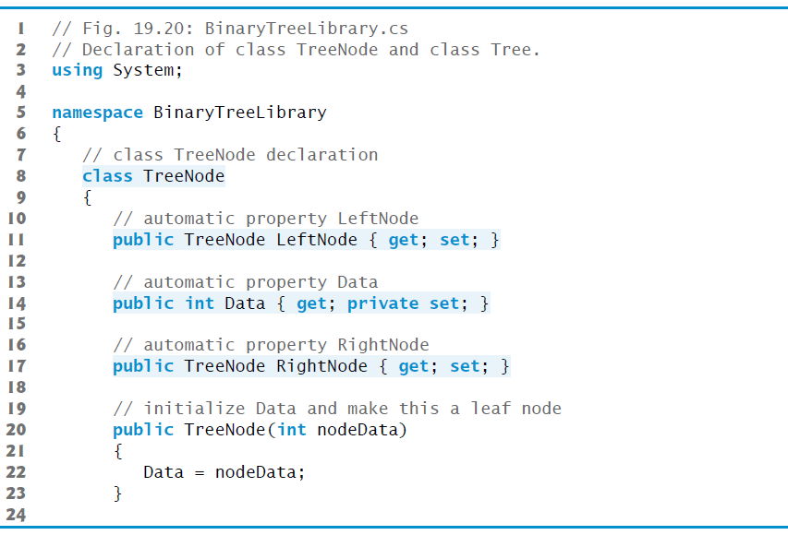
Figure 19.20 Declaration of Class TreeNode and Class Tree (1 of 7)

Slide 86
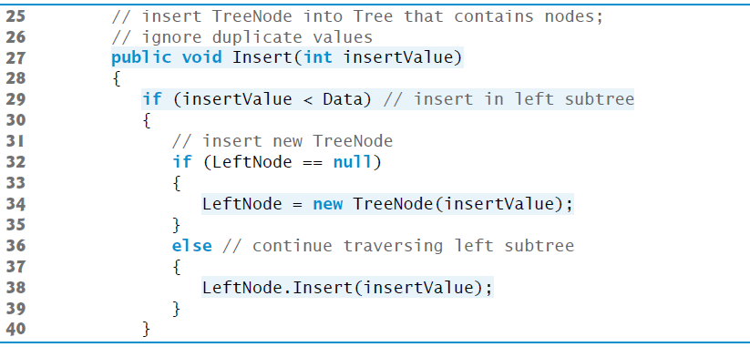
Figure 19.20 Declaration of Class TreeNode and Class Tree (2 of 7)

Slide 87
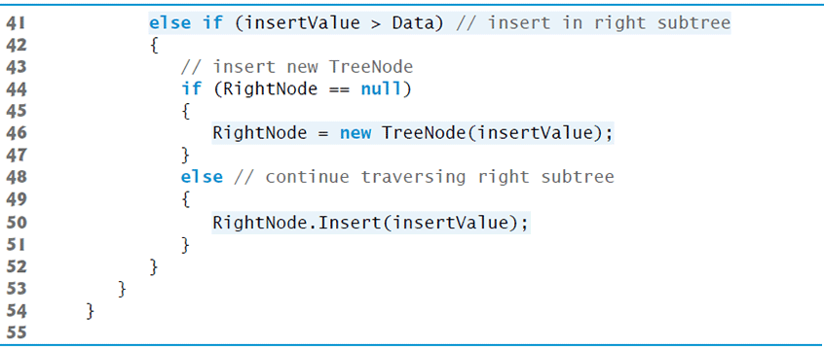
Figure 19.20 Declaration of Class TreeNode and Class Tree (3 of 7)

Slide 88
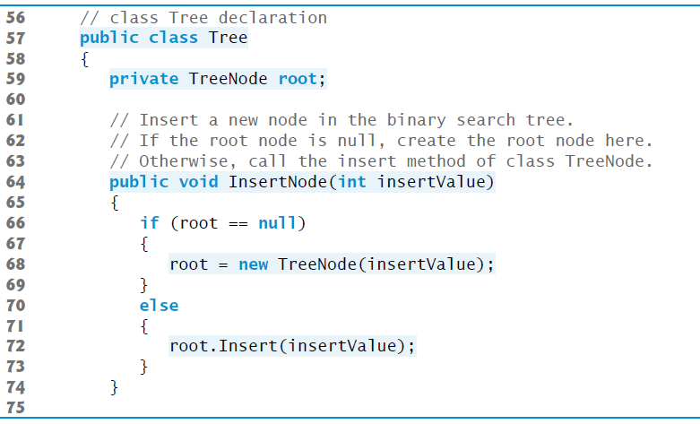
Figure 19.20 Declaration of Class TreeNode and Class Tree (4 of 7)

Slide 89
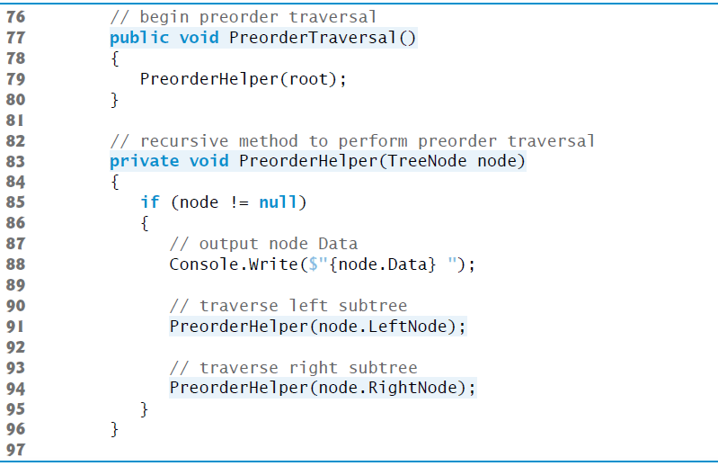
Figure 19.20 Declaration of Class TreeNode and Class Tree (5 of 7)

Slide 90
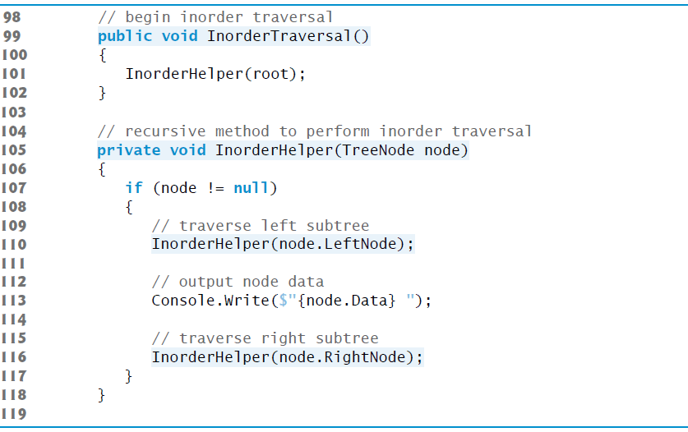
Figure 19.20 Declaration of Class TreeNode and Class Tree (6 of 7)

Slide 91
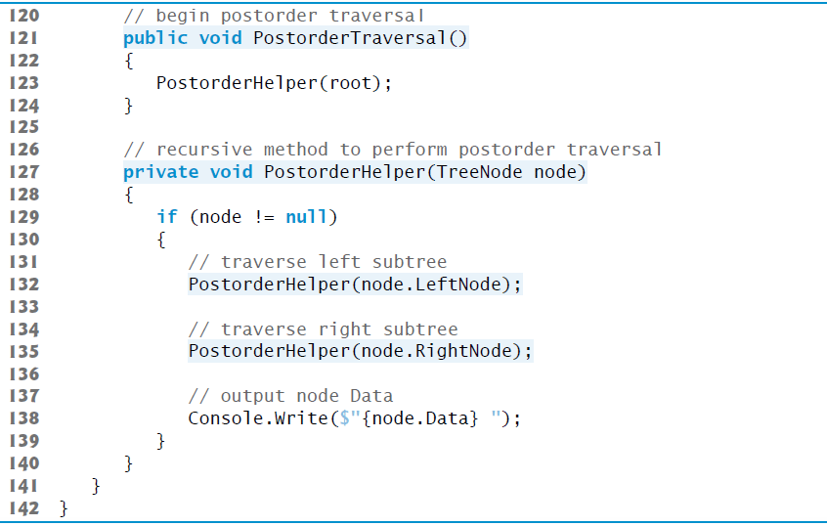
Figure 19.20 Declaration of Class TreeNode and Class Tree (7 of 7)

Slide 92
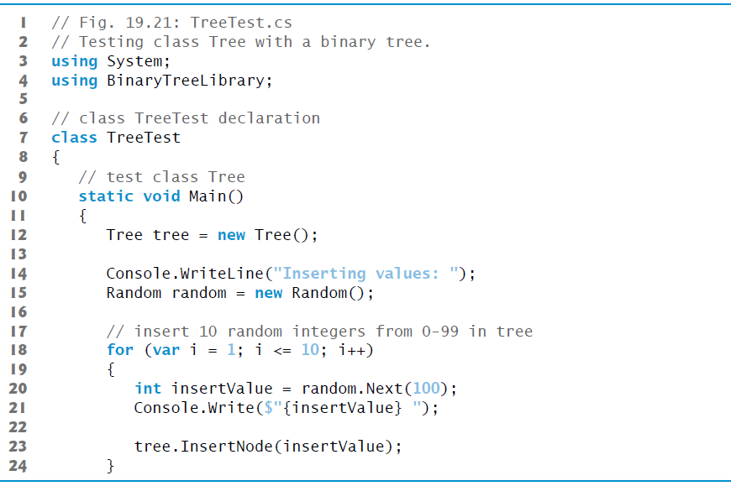
Figure 19.21 Testing Class Tree with a Binary Tree (1 of 3)

Slide 93
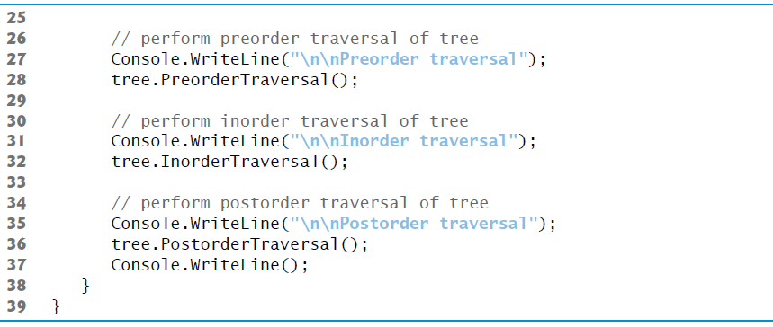
Figure 19.21 Testing Class Tree with a Binary Tree (2 of 3)

Slide 94
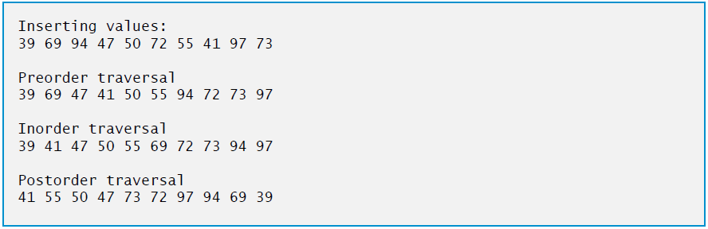
Figure 19.21 Testing Class Tree with a Binary Tree (3 of 3)

Slide 95
19.7 Trees (5 of 12)
For the following discussion, we use the binary search tree shown in Figure 19.22.

Slide 96

Figure 19.22 Binary search tree

Slide 97
19.7 Trees (6 of 12)
Inorder Traversal Algorithm
Method InorderHelper (lines 105–118) defines the steps for an inorder traversal.
Those steps are as follows:
If the argument is null, do not process the tree.
Traverse the left subtree with a call to InorderHelper
Process the value in the node
Traverse the right subtree with a call to InorderHelper

Slide 98
19.7 Trees (7 of 12)
The inorder traversal does not process the value in a node until the values in that node’s left subtree are processed. The inorder traversal of the tree in Figure 19.22(see slide 96) is
6 13 17 27 33 42 48
The inorder traversal of a binary search tree displays the node values in ascending order.
The process of creating a binary search tree actually sorts the data (when coupled with an inorder traversal)—thus, this process is called the binary-tree sort.

Slide 99
19.7 Trees (8 of 12)
Preorder Traversal Algorithm
Method PreorderHelper (lines 83–96) defines the steps for a preorder traversal.
Those steps are as follows:
If the argument is null, do not process the tree.
Process the value in the node
Traverse the left subtree with a call to PreorderHelper
Traverse the right subtree with a call to PreorderHelper

Slide 100
19.7 Trees (9 of 12)
The preorder traversal processes the value in each node as the node is visited.
After processing the value in a given node, the preorder traversal processes the values in the left subtree, then the values in the right subtree.
The preorder traversal of the tree in Figure 19.22(see slide 96) is
27 13 6 17 42 33 48

Slide 101
19.7 Trees (10 of 12)
Postorder Traversal Algorithm
Method PostorderHelper (lines 127-140) defines the steps for a postorder traversal.
Those steps are as follows:
If the argument is null, do not process the tree.
Traverse the left subtree with a call to PostorderHelper.
Traverse the right subtree with a call to PostorderHelper
Process the value in the node

Slide 102
19.7 Trees (11 of 12)
The postorder traversal processes the value in each node after the values of all that node’s children are processed.
The postorder traversal of the tree in Figure 19.22(see slide 96) is
6 17 13 33 48 42 27

Slide 103
19.7 Trees (12 of 12)
Duplicate Elimination
A binary search tree facilitates duplicate elimination.
Searching a binary tree for a value that matches a key value is fast, especially for tightly packed binary trees.

Slide 104
19.7.2 Binary Search Tree of IComparable Objects (1 of 2)
polymorphic capabilities by implementing TreeNode and Tree classes that manipulate objects of any type that implements interface IComparable (namespace System).
It is imperative that we be able to compare objects stored in a binary search tree, so we can determine the path to the insertion point of a new node.
Classes that implement IComparable define method CompareTo, which compares the object that invokes the method with the object that the method receives as an argument.
In our next example, we take advantage of

Slide 105
19.7.2 Binary Search Tree of IComparable Objects (2 of 2)
Figures 19.23–19.24(see slide 113) enhance the program of Section 19.7.1 to manipulate IComparable objects.
One restriction on the new versions of classes TreeNode and Tree is that each Tree object can contain objects of only one type (e.g., all strings or all doubles).
If a program attempts to insert multiple types in the same Tree object, ArgumentExceptions will occur.
We modified only five lines of code in class TreeNode (lines 14, 20, 27, 29 and 41 of Figure 19.23) and one line of code in class Tree (line 64) to enable processing of IComparable objects.

Slide 106
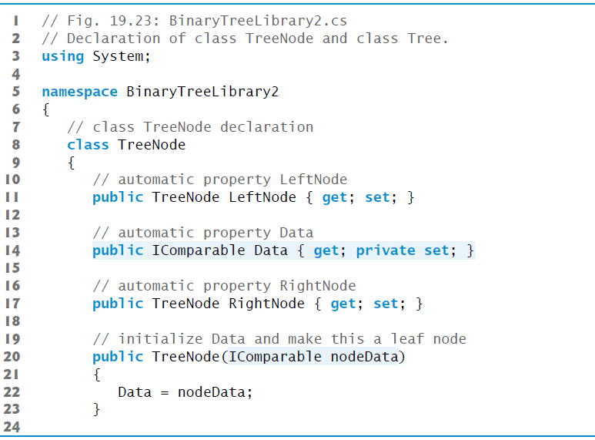
Figure 19.23 Declaration of Class TreeNode and Class Tree (1 of 7)

Slide 107
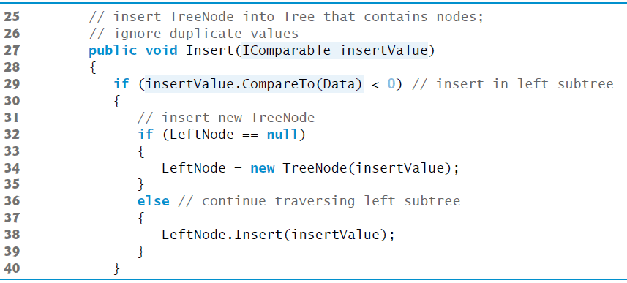
Figure 19.23 Declaration of Class TreeNode and Class Tree (2 of 7)

Slide 108

Figure 19.23 Declaration of Class TreeNode and Class Tree (3 of 7)

Slide 109

Figure 19.23 Declaration of Class TreeNode and Class Tree (4 of 7)

Slide 110

Figure 19.23 Declaration of Class TreeNode and Class Tree (5 of 7)

Slide 111

Figure 19.23 Declaration of Class TreeNode and Class Tree (6 of 7)

Slide 112

Figure 19.23 Declaration of Class TreeNode and Class Tree (7 of 7)

Slide 113

Figure 19.24 Testing Class Tree with IComparable Objects (1 of 5)

Slide 114

Figure 19.24 Testing Class Tree with IComparable Objects (2 of 5)

Slide 115

Figure 19.24 Testing Class Tree with IComparable Objects (3 of 5)

Slide 116

Figure 19.24 Testing Class Tree with IComparable Objects (4 of 5)

Slide 117

Figure 19.24 Testing Class Tree with IComparable Objects (5 of 5)

Slide 118

Copyright

